Slide 3
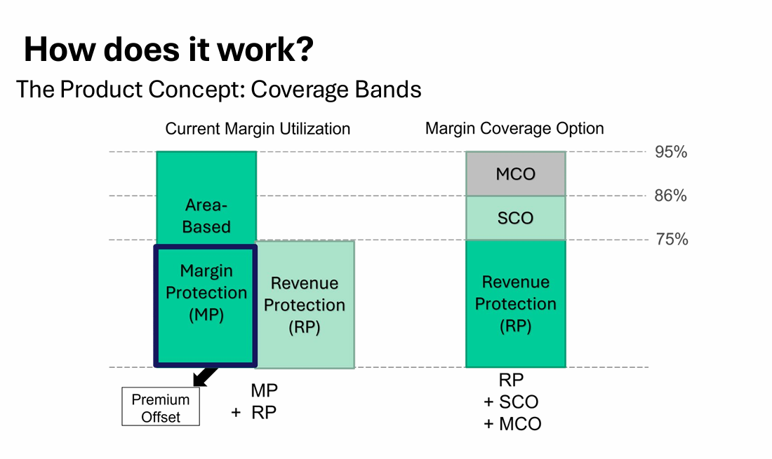

Slide 6
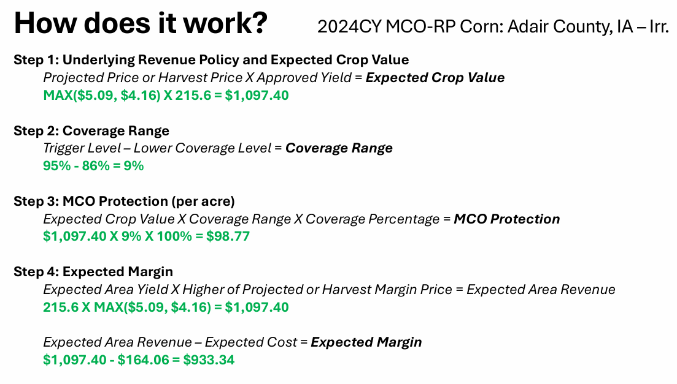
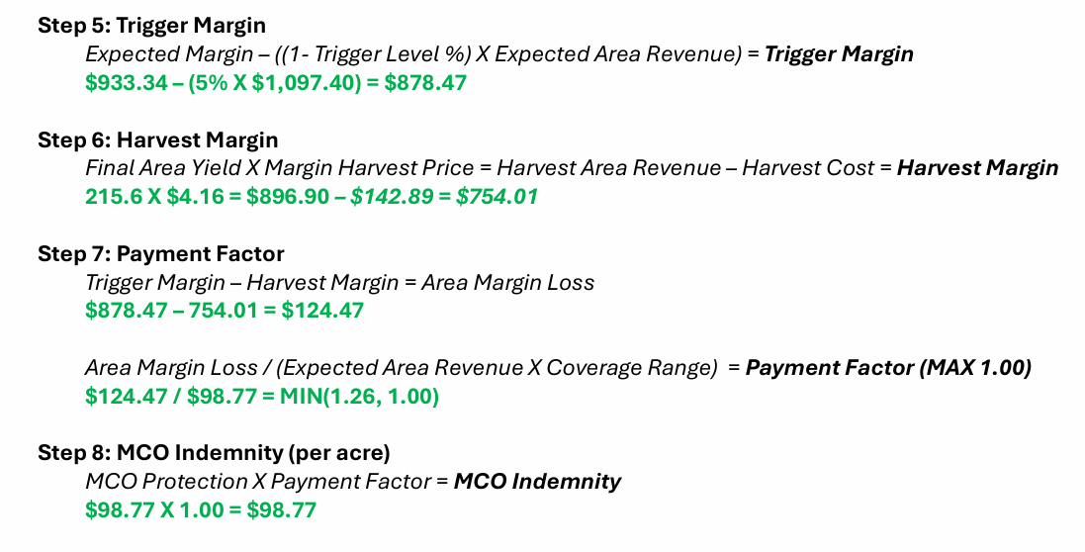

Slide 7
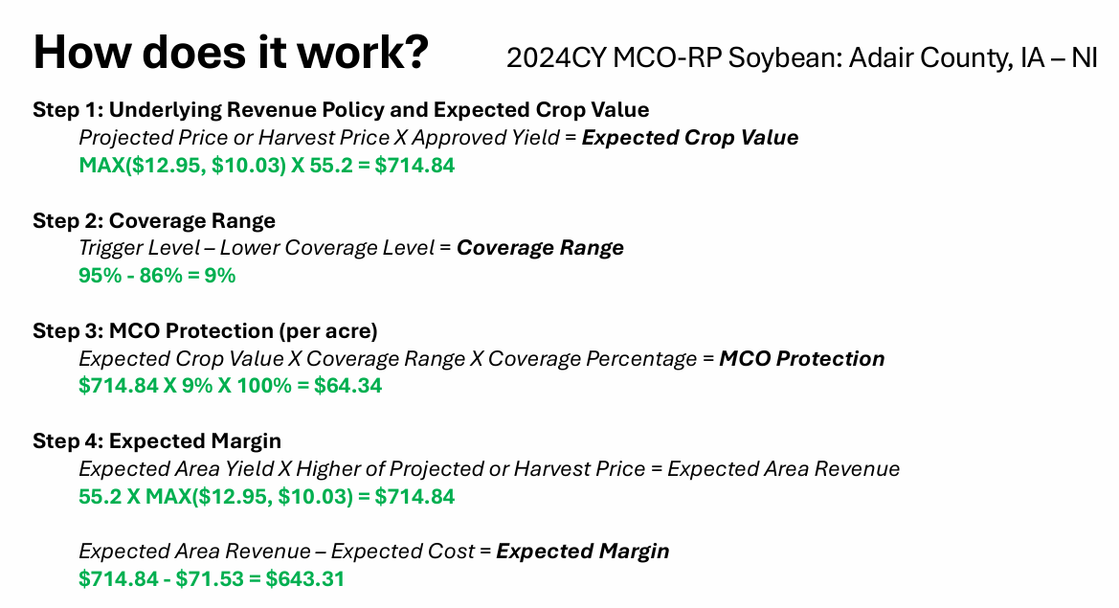
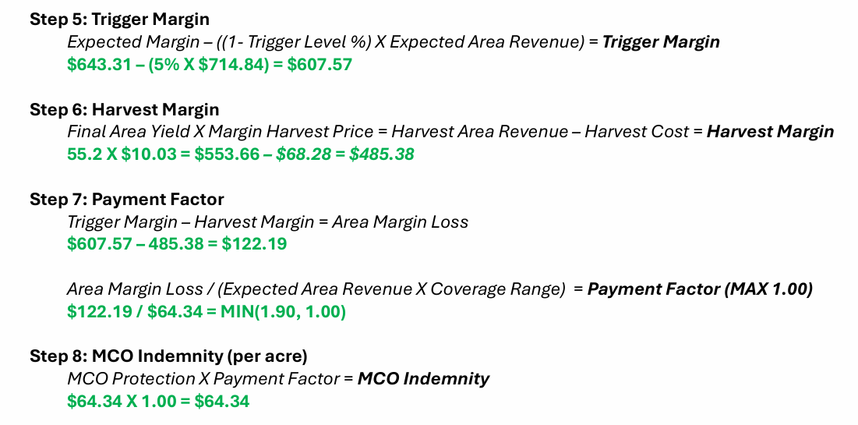
These are only a few examples. Please speak to your agent for additional information.

Slide 8
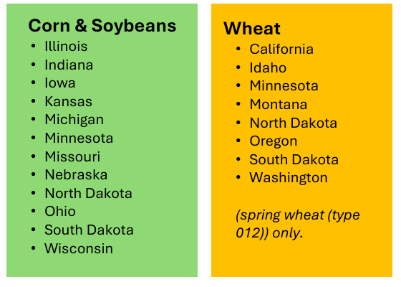
Current availability in the SKCI & KCI Insurance areas:

Slide 10
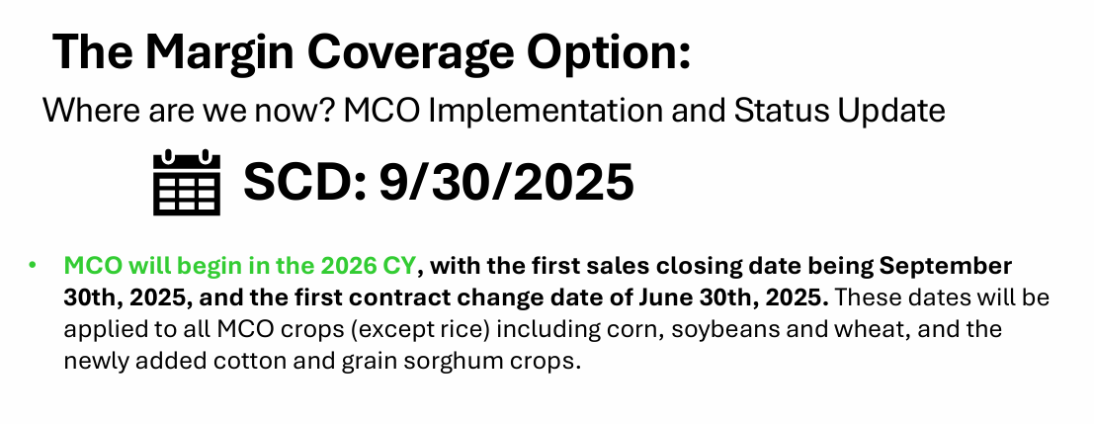
MCO
(Margin Coverage Option)
This Photo by Unknown Author is licensed under CC BY-SA

